Slide 1
Java Packages

Slide 2
A java package is a group of similar types of classes, interfaces and sub-packages.
Package in java can be categorized in two form, built-in package and user-defined package.
There are many built-in packages such as java, lang, awt, javax, swing, net, io, util, sql etc.
Advantage of Java Package
1) Java package is used to categorize the classes and interfaces so that they can be easily maintained.
2) Java package provides access protection.
3) Java package removes naming collision.

Slide 3
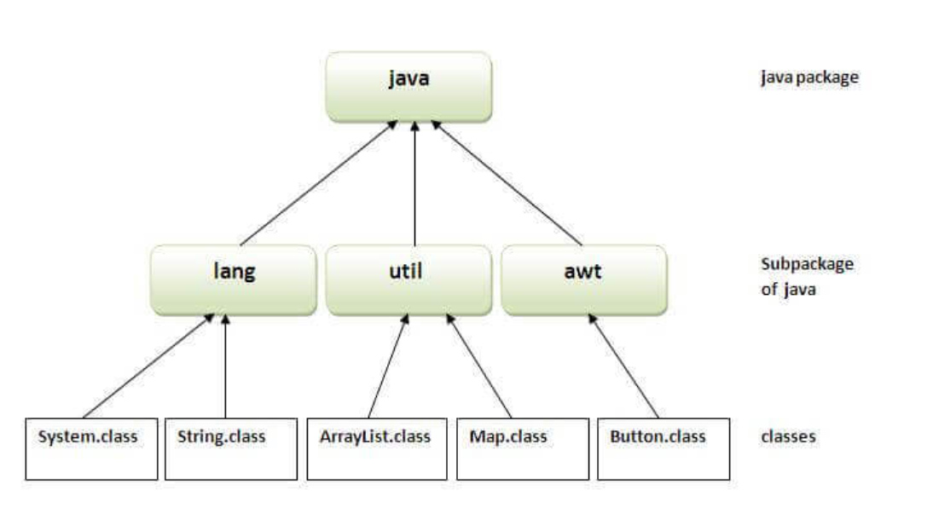

Slide 4
Simple example of java package
The package keyword is used to create a package in java.
//save as Simple.java
package mypack;
public class Simple{
public static void main(String args[]){
System.out.println("Welcome to package");
}
}
How to compile java package
If you are not using any IDE, you need to follow the syntax given below:
javac -d directory javafilename
For example
javac -d . Simple.java

Slide 5
The -d switch specifies the destination where to put the generated class file. You can use any directory name like /home (in case of Linux), d:/abc (in case of windows) etc. If you want to keep the package within the same directory, you can use . (dot).
How to run java package program
You need to use fully qualified name e.g. mypack.Simple etc to run the class.
To Compile: javac -d . Simple.java
To Run: java mypack.Simple

Slide 6
How to access package from another package?
There are three ways to access the package from outside the package.
import package.*;
import package.classname;
fully qualified name.
1) Using packagename.*
If you use package.* then all the classes and interfaces of this package will be accessible but not subpackages.
The import keyword is used to make the classes and interface of another package accessible to the current package.
Example of package that import the packagename.*

